Slide 1
HISTORY AND PERIODS OF EUROPEAN MUSIC

Slide 2
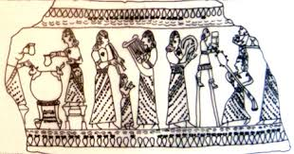
HISTORY OF MUSIC

Slide 3
The major time divisions of classical music up to 1900 are the early music period, which includes Medieval (500–1400) and Renaissance (1400–1600) eras, and the Common practice period, which includes the Baroque (1600–1750), Classical (1750–1830) and Romantic (1804–1910) eras. Since 1900, classical periods have been reckoned more by calendar century than by particular stylistic movements that have become fragmented and difficult to define.

Slide 4
The 20th century calendar period (1901–2000) includes most of the early modern musical era (1890–1930), the entire high modern (mid 20th-century), and the first 25 years of the contemporary or postmodern musical era (1975–current). The 21st century has so far been characterized by a continuation of the contemporary/postmodern musical era.

Slide 5
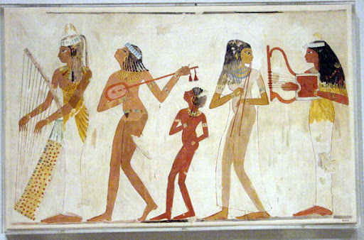

Slide 6
The dates are generalizations, since the periods and eras overlap and the categories are somewhat arbitrary, to the point that some authorities reverse terminologies and refer to a common practice 'era' comprising baroque, classical, and romantic 'periods

Slide 7
. Beethoven, who is often described as a founder of the Romantic era, and Brahms, who is classified as Romantic, also used counterpoint and fugue, but other characteristics of their music define their era

Slide 8
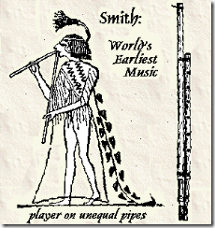

Slide 9
ANCIENT MUSIC
Burgh (2006), suggests that the roots of Western classical music ultimately lie in ancient Egyptian art music via cheironomy and the ancient Egyptian orchestra, which dates to 2695 BC.

Slide 10
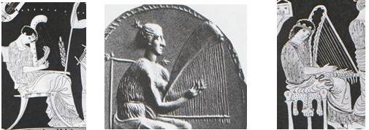
The development of individual tones and scales was made by ancient Greeks such as Aristoxenus and Pythagoras. Pythagoras created a tuning system and helped to codify musical notation.

Slide 11
Ancient Greek instruments such as the aulos (a reed instrument) and the lyre (a stringed instrument similar to a small harp) eventually led to the modern-day instruments of a classical orchestra.

Slide 12
Medieval music
Many of the instruments used to perform medieval music still exist, but in different forms. Medieval instruments included the wood flute (which in the 2000s is made of metal), the recorder and plucked string instruments like the lute.

Slide 13
. Medieval instruments in Europe had most commonly been used singly, often self accompanied with a drone note, or occasionally in parts.

Slide 14
Polyphonic vocal genres, which used multiple independent vocal melodies, began to develop during the high medieval era, becoming prevalent by the later 13th and early 14th.

Slide 15
Renaissance music
Many instruments originated during the Renaissance; others were variations of, or improvements upon, instruments that had existed previously.

Slide 16
As in the modern day, instruments may be classified as brass, strings, percussion, and Stringed instruments included the viol, the harp-like lyre, the hurdy-gurdy, the cittern and the lute..

Slide 17
.Vocal music in the Renaissance is noted for the flourishing of an increasingly elaborate polyphonic style.. Towards the end of the period, the early dramatic precursors of opera such as monody, the madrigal comedy, and the intermedio are seen.

Slide 18
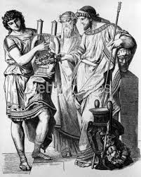

Slide 19
Baroque music
Baroque instruments included some instruments from the earlier periods (e.g., the hurdy-gurdy and recorder) and a number of new instruments (e.g, the cello, contrabass and fortepiano).

Slide 20
Keyboard instruments included the clavichord, tangent piano, the fortepiano (an early version of the piano), the harpsichord and the pipe organ.

Slide 21
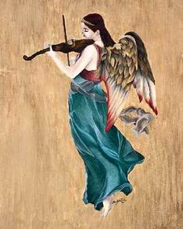

Slide 22
One major difference between Baroque music and the classical era that followed it is that the types of instruments used in ensembles were much less standardized.

Slide 23
Vocal developments in the Baroque era included the development of opera types such as opera seria and opéra comique, oratorios, cantatas and chorale.

Slide 24
CLASSICAL MUSIC
The term "classical music" has two meanings: the broader meaning includes all Western art music from the Medieval era to the 2000s, and the specific meaning refers to the music from the 1750s to the early 1830s–the era of Mozart and Haydn.

Slide 25
The Classical era stringed instruments were the four instruments which form the string section of the orchestra: the violin, viola, cello and contrabass.

Slide 26
Brass instruments included the buccin, the ophicleide (a serpent replacement which was the precursor of tuba) and the natural.

Slide 27
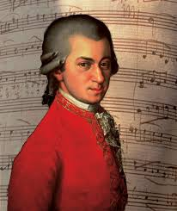

Slide 28
The composer's instrumentation usually included paired flutes, oboes, clarinets, bassoons, horns and trumpets.

Slide 29
. Piccolo, contrabassoon, and trombones add to the triumphal finale of his Symphony No. 5. A piccolo and a pair of trombones help deliver "storm" and "sunshine" in the Sixth.

Slide 30
For several decades after he died, symphonic instrumentation was faithful to Beethoven's well-established model, with few exceptions.

Slide 31
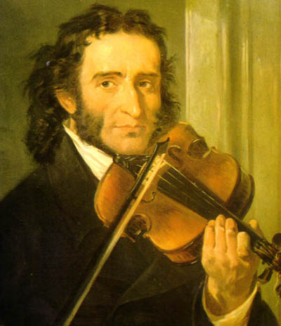

Slide 32
Romantic music
In the Romantic era, the modern piano, with a more powerful, sustained tone and a wider range took over from the more delicate-sounding fortepiano.

Slide 33
Saxophones appear in some scores from the late 19th century onwards. While appearing only as featured solo instruments in some works, for example Maurice Ravel's orchestration of Modest Mussorgsky's Pictures at an Exhibition and Sergei Rachmaninoff's Symphonic Dances, the saxophone is included in other works, such as Ravel's Boléro, Sergei Prokofiev's Romeo and Juliet Suites 1 and 2 and many other works as a member of the orchestral ensemble.

Slide 34
The euphonium is featured in a few late Romantic and 20th-century works, usually playing parts marked "tenor tuba", including Gustav Holst's The Planets, and Richard Strauss's Ein Heldenleben.

Slide 35
MODERN ERA
Electric instruments such as the electric guitar, the electric bass and the ondes Martenot appear occasionally in the classical music of the 20th and 21st centuries.

Slide 36
Many instruments today associated with popular music filled important roles in early classical music, such as bagpipes, vihuelas, hurdy-gurdies, and some woodwind instruments.

Slide 37
MUSIC EDUCATION
During the 1990s, several research papers and popular books wrote on what came to be called the "Mozart effect": an observed temporary, small elevation of scores on certain tests as a result of listening to Mozart's works.

Slide 38
This popularized version of the theory was expressed succinctly by the New York Times music columnist Alex Ross: "researchers... have determined that listening to Mozart actually makes you smarter.

Slide 39
In 1996–1997, a research study was conducted on a large population of middle age students in the Cherry Creek School District in Denver, Colorado, USA. The study showed that students who actively listen to classical music before studying had higher academic scores.

Slide 40
The research further indicated that students who listened to the music prior to an examination also had positively elevated achievement scores. Students who listened to rock-and-roll or country had moderately lower scores. The study further indicated that students who used classical during the course of study had a significant leap in their academic performance; whereas, those who listened to other types of music had significantly lowered academic scores.

Slide 41
GTO
FINE ARTS HIGH SHOOL
2016

